Slide 1
程式範例

Slide 2
Folder
demo.py (模型庫)
polymer2.hdf5 (模型儲存的權重)
forward_winform.py (執行正向預測用)
Inverse_winform.py (執行反向設計用)
Csv_file (folder for forward _winform.py 輸入csv檔)
Forward_pic (folder for forward _winform.py 輸出圖檔)
Preview_pic (folder for Inverse_winform.py preview圖檔)
Overlap_pic (folder for Inverse_winform.py疊圖檔)
Suggest_parameter(folder for Inverse_winform.py 建議配方值csv)

Slide 3
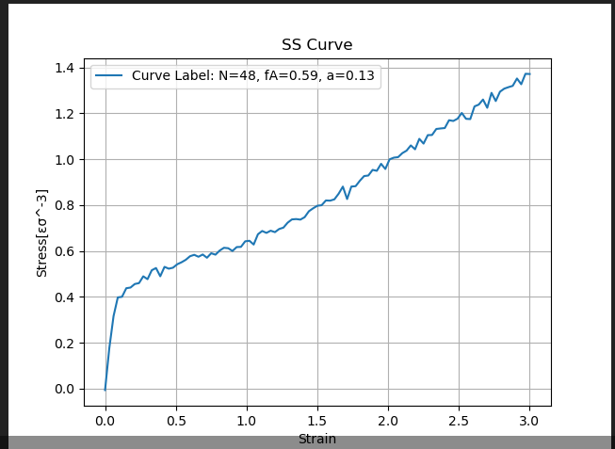
forward_winform.py
Input
三變數的設定值
N
fA
a
執行方式
python foward_winform.py --N 48 --fA 0.59 --a 0.13 --save_dir “路徑”
save_dir可自訂路徑or默認forward_pic
存檔資料夾: forward_pic
圖檔名稱: curve_N{N}_fA{fA}_a{a}.png
Output
SS-Cuve

Slide 4

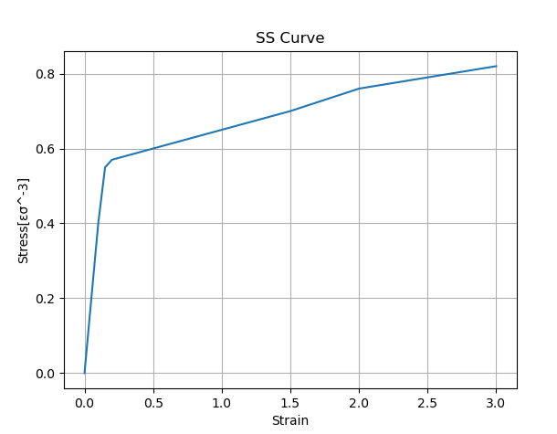
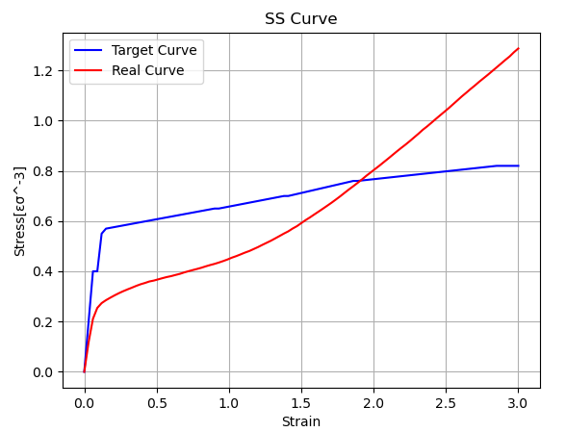
inverse_winform.py
輸出三變數的建議值
存檔於suggest_parameter folder
N
fA
a
x1, y1;x1, y2….格式輸入座標
python inverse_winform --coordinates "-0.1,0.3;1.0,0.5;3.5,0.7"
or直接匯入座標csv檔
python inverse_winform.py --csv csv_file\Inverse_input.csv
輸出SS-Cuve Preview
存檔於preview_pic folder
輸出實際 vs 目標 SS-curve 疊圖
存檔於overlap_pic folder

Slide 5
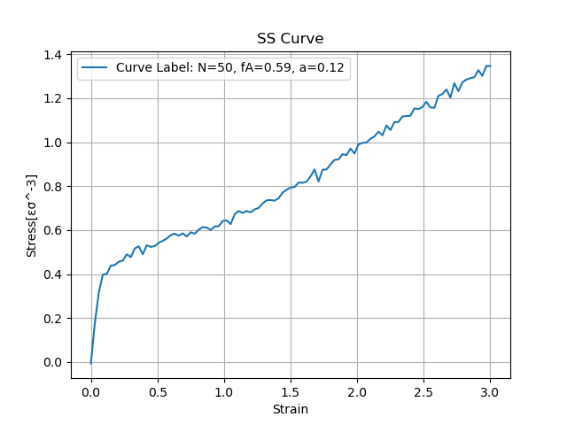
foward_analysis.py
from demo import *
import physbo # need download VS build tool
import scipy
import itertools
import matplotlib.pyplot as plt
import os
os.environ['KMP_DUPLICATE_LIB_OK'] = 'True'
import tensorflow as tf
model.load_weights('C:/Users/B20466/Desktop/梓堂/Project/材料AI/Thermoplastic Elastomer inverse design/polymer2.hdf5') #polymer.hdf5 路徑
#Design target
#target = np.linspace(0,2.0,101)
x_axis = np.linspace(0, 3, 101)
def curve_analysis(N,fA,a):
x = np.array([N,fA,a])
curve = model.predict(x).reshape(101,)
return curve N=50
fA=0.59
a=0.12
target = curve_analysis(48, 0.59, 0.12)
#print(target.shape)
label = f"Curve Label: N={N}, fA={fA}, a={a}"
x_label = "Strain"
y_label = "Stress[εσ^-3]"
plt.plot(x_axis, target, label=label) # 添加曲線標籤
plt.xlabel(x_label) # 設定 X 軸標籤
plt.ylabel(y_label) # 設定 Y 軸標籤
plt.title("SS Curve") # 設定圖表標題
plt.legend() # 顯示圖例
plt.grid(True) # 顯示網格
# 顯示圖表
plt.show()
Input
三變數的設定值
N
fA
a
Output
SS-Cuve

Slide 6
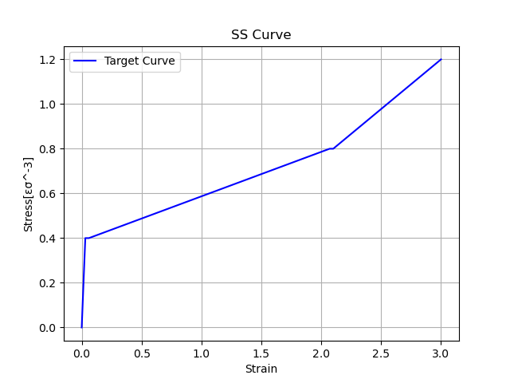
Inverse_design.py_(1)
Input
from demo import *
import physbo # need download VS build tool
import scipy
import itertools
import matplotlib.pyplot as plt
import os
os.environ['KMP_DUPLICATE_LIB_OK'] = 'True'
import tensorflow as tf
model.load_weights('C:/Users/B20466/Desktop/梓堂/Project/材料AI/NTU_Polymer_inverse/polymer.hdf5') #C:/Users/B20466/Desktop/NTU_Polymer_inverse/polymer.hdf5
#Design target
#target = np.linspace(0,2.0,101)
x_axis = np.linspace(0, 3, 101)
def settarget(x1,x2,y1,y2,y3):
line1 = np.linspace(0,y1,x1)
line2 = np.linspace(y1,y2,x2-x1)
line3 = np.linspace(y2,y3,101-x2)
combined_line = np.concatenate((line1, line2, line3))
return combined_line
target = settarget(2,70,0.4,0.8,1.2)
# 繪製曲線
x_label = "Strain"
y_label = "Stress[εσ^-3]"
plt.plot(x_axis, target, label="Target Curve", color = 'blue') # 添加曲線標籤
plt.xlabel(x_label) # 設定 X 軸標籤
plt.ylabel(y_label) # 設定 Y 軸標籤
plt.title("SS Curve") # 設定圖表標題
plt.legend() # 顯示圖例
plt.grid(True) # 顯示網格
# 顯示圖表
plt.show()
SS-Curve 的座標輸入，須廠商支援滑窗設計。
最多輸入100點
預設座標(0, 0)
最右邊二點外插延伸至x=3
支援輸入csv檔
Output_1
SS-Cuve Preview

Slide 7
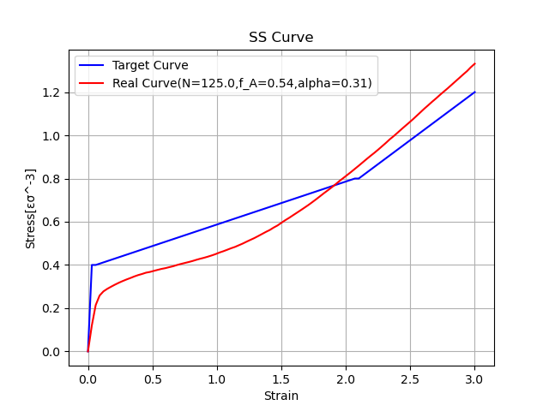
Inverse_design.py_(2)
Output_2
#Design space
X_0=np.linspace(40.0,140.0,101) #40~140抓101個data
X_1=np.linspace(0.1,0.6,51)
X_2=np.linspace(0.0,0.5,51)
candidate = []
for i in X_0:
for j in X_1:
for k in X_2:
candidate.append(np.array([i,j,k])) #約25w筆 input feature
X = np.array(candidate) #input 25w x 3
print('c:',type(candidate))
print('x:',type(X))
###############
#define the simulator class and find the minimum value of a one-dimensional function using PHYSBO
class simulator:
def __call__(self,action):
action_idx = action[0]
x = X[action_idx]
#objective function
fx = np.sum((model.predict(x)-target)**2)/101 #loss
fx_list.append(fx) #loss for all input
x_list.append(X[action_idx])
return -fx
#set policy
policy = physbo.search.discrete.policy(test_X=X)
# set seed
policy.set_seed(0)
fx_list=[]
x_list=[]
#need random data to vuild gauss distribution
res=policy.random_search(max_num_probes=10, simulator=simulator())
res = policy.bayes_search(max_num_probes=3, simulator=simulator(), score='TS',interval=0, num_rand_basis=500)
best_fxs, best_actions = policy.history.export_sequence_best_fx()
best_fx = best_fxs[-1]
best_X = X[best_actions[-1],:]
print(f"best_fx: {best_fx} at N={best_X[0]},f_A={best_X[1]},alpha={best_X[2]}")
best_sol = [best_X[0],best_X[1], best_X[2]]
real = model.predict(best_X).reshape(101,)
# 繪製曲線
x_label = "Strain"
y_label = "Stress[εσ^-3]"
plt.plot(x_axis, target, label="Target Curve", color = 'blue') # 添加曲線標籤
plt.plot(x_axis, real, label="Real Curve(N=125.0,f_A=0.54,alpha=0.31)", color = 'red') # 添加曲線標籤
plt.xlabel(x_label) # 設定 X 軸標籤
plt.ylabel(y_label) # 設定 Y 軸標籤
plt.title("SS Curve") # 設定圖表標題
plt.legend() # 顯示圖例
plt.grid(True) # 顯示網格
# 顯示圖表
plt.show()
輸出三變數的建議值
N
fA
a
Output_3
實際 vs 目標 SS-curve 疊圖

Slide 8
您好
剛才teams的討論,須調整重點如下：
1.
取消兩個python產圖時的顯示彈窗,直接落地存檔到[pic]資料夾,檔名可自取
2.
調整第二段python程式
讀取[Inverse_input.csv]檔的範例座標檔
(檔名可另取,最上面的X,Y標題如果會造成混淆可以刪除)
執行完第二段python後,分別在[pic]存成:
[底圖][疊圖][三個建議值]
[三個建議值可以考慮輸出成附錄[Inverse_output.csv]格式,如果第一行標題會造成困擾可省略
我會在winform程式中對應按紐,分別讀取這三個資料,顯示在畫面上
感謝合作

